Slide 1

Network Layer Routing Algorithm Distance Vector Routing
Lecture 11 | CSE421 – Computer Networks
Department of Computer Science and Engineering School of Data & Science

Slide 2

Objectives
understand principles behind network layer services:
routing algorithms
distance vector
link state

Slide 3
Autonomous Systems
Internet is divided into autonomous systems (AS).
An AS = a group of networks and routers controlled by one organization.
Routing inside an autonomous systems(AS) is called intra-domain routing.
Routing between autonomous systems(AS) is called inter-domain routing.

Slide 4
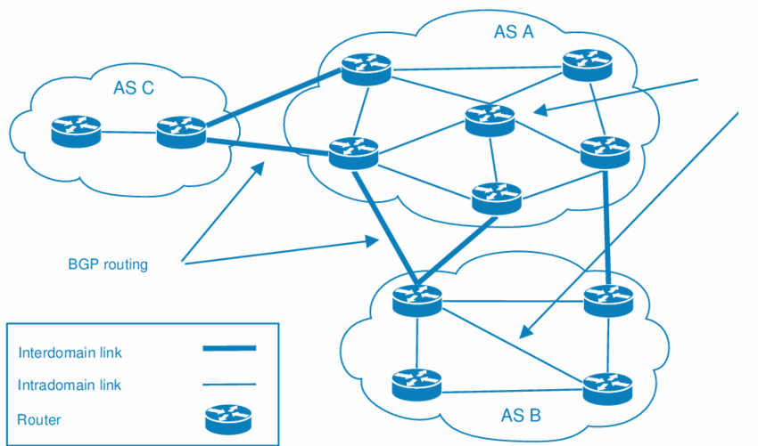
Autonomous Systems
RIP/ OSPF

Slide 5
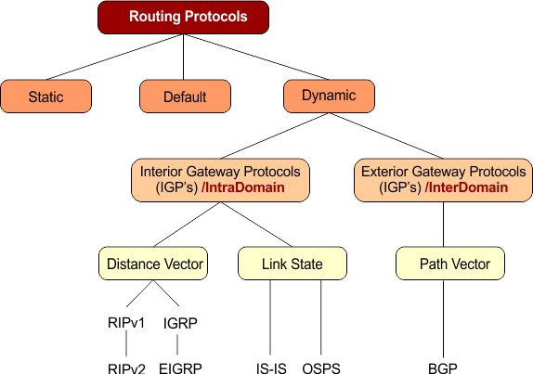
Popular Routing Protocols

Slide 6
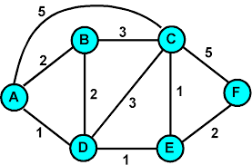
Routing Algorithms
Given a set of routers and links connecting the routers.
Routing algorithm finds a “good” path from the source to destination router.
Good path = Least cost path

Slide 7
Routing Algorithm classification
Global:
Every router knows the whole network (all nodes, all links, and their costs).
Each router builds a complete map (topology).
Uses link state algorithms (like Dijkstra’s shortest path).
Decentralized:
Each router only knows about its neighbors and the cost to reach them.
Routers share information with neighbors and update step by step.
Uses distance vector algorithms (like Bellman-Ford).

Slide 8
Distance Vector Algorithm

Slide 9
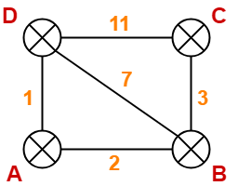
Distance vector algorithm
Based on Bellman-Ford Algorithm.
Each router finds shortest paths to all destinations.
Shortest path cost can be:
Hop count
Link delay
Bandwidth
Uses a weighted network (topology).
Notes:
9

Slide 10
How Does It Work?
Each router keeps a Distance Vector (table).
Router shares its table with neighbors regularly.
When a router gets a table from a neighbor, it updates its own table using the Bellman-Ford rule.
Repeat until all routers know the shortest paths.
Notes:
10

Slide 11
NODE D Table
NODE C Table
Node | Distance
A | 1
B | 7
C | 11
D | 0
Node | Distance
A | No Info
B | 3
C | 0
D | 11

Slide 12
Periodic Updates of Distance Vector
Routers regularly send their entire routing table to neighbors (e.g., every 30 seconds in RIP).
This is simple but inefficient.
Each Router is only aware of the:
The addresses of its own interfaces.
The addresses of neighbors running the same routing protocol.
Notes:
Inefficient: Updates consume bandwidth and router CPU resources.
Periodic updates are always sent even there have been no changes for weeks or months.

Slide 13
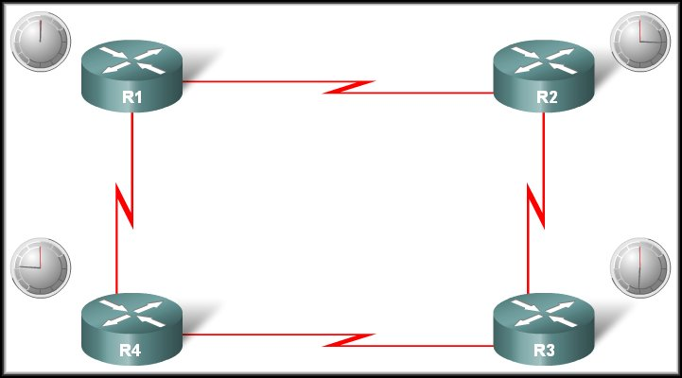

Operation of Distance Vector
Periodic Updates:
R1 Update Timer expires
Neighbour of R1
Updates sent.
Broadcast!
R1 is unaware of R3 and its networks
Neighbour of R1

Slide 14
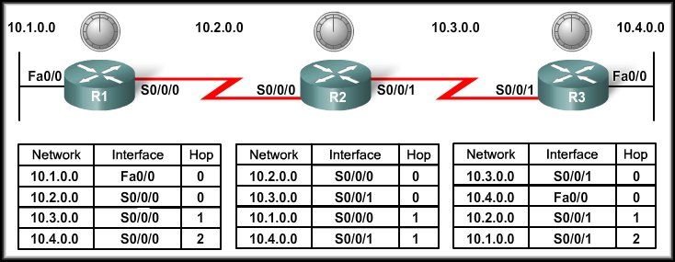
Distance Vector Routing Protocols
Network Discovery

Slide 15
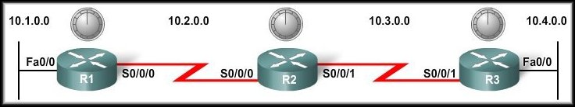
Cold Start
Network Discovery:
Is part of the process of the routing protocol algorithm that enables routers to learn about remote networks for the first time.

Slide 16
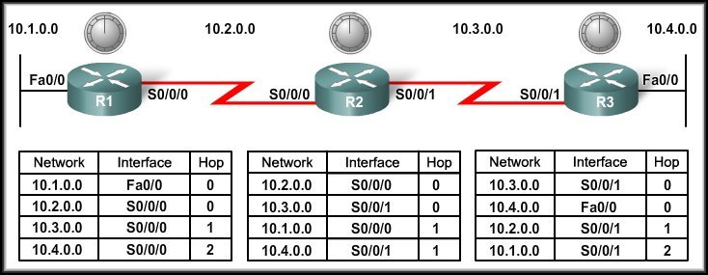
Cold Start
When a router powers up:
Knows nothing about the network topology.
Knows only the information saved in NVRAM.
Sends updates about its known networks out all ports.

Slide 17
Initial Exchange of Routing Information
10.1.0.0
Notes:
Sends an update about network 10.1.0.0 out the Serial 0/0/0 interface with a metric of 1.
Sends an update about network 10.2.0.0 out the Fa0/0 interface with a metric of 1.

Slide 18
Initial Exchange of Routing Information
10.1.0.0
10.3.0.0
10.2.0.0
Notes:
Sends an update about network 10.3.0.0 out the Serial 0/0/0 interface with a metric of 1.
Sends an update about network 10.2.0.0 out the Serial 0/0/1 interface with a metric of 1.

Slide 19
Initial Exchange of Routing Information
10.1.0.0
10.4.0.0
10.3.0.0
10.2.0.0
Notes:
Sends an update about network 10.4.0.0 out the S0/0/0 interface with a metric of 1.
Sends an update about network 10.3.0.0 out the Fa0/0 interface with a metric of 1.

Slide 20
Initial Exchange of Routing Information
10.3.0.0
10.2.0.0
Notes:
R1 Receives the update from R2 about network 10.3.0.0 and adds it to its routing table.
R3 Receives the update from R2 about network 10.2.0.0 and adds it to its routing table.

Slide 21
Initial Exchange of Routing Information
10.1.0.0
10.4.0.0
Notes:
R2 Receives the update from R1 about network 10.1.0.0 and adds it to its routing table.
R2 Receives the update from R3 about network 10.4.0.0 and adds it to its routing table.

Slide 22
Next Exchange of Routing Information
10.1.0.0
Notes:
Sends an update about network 10.1.0.0 out the S0/0/0 interface with a metric of 1 - AGAIN!
When R2 receives the update, there is no change in information so the update is ignored.

Slide 23
Next Exchange of Routing Information
NEW
NEW
10.3.0.0
10.4.0.0
10.1.0.0
10.2.0.0
Notes:
Sends an update about networks 10.3.0.0 with a metric of 1 and 10.4.0.0 with a metric of 2 out the Serial 0/0/0 interface.
Similarly sends updates about networks 10.1.0.0 with a metric of 2 and 10.2.0.0 with a metric of 1 out the Serial 0/0/1 interface.

Slide 24
Next Exchange of Routing Information
10.4.0.0
Notes:
Sends an update about network 10.4.0.0 out the S0/0/0 interface with a metric of 1 - AGAIN!
When R2 receives the update, there is no change in information so the update is ignored.

Slide 25
Next Exchange of Routing Information
10.3.0.0
10.4.0.0
Notes:
R1 receives an update from R2 about network 10.3.0.0 and there is no change – update ignored.
R1 receives an update from R2 about network 10.4.0.0 (new) and adds it to its routing table.

Slide 26
Next Exchange of Routing Information
10.1.0.0
10.2.0.0
Notes:
R3 receives an update from R2 about network 10.2.0.0 and there is no change – update ignored.
R3 receives an update from R2 about network 10.1.0.0 (new) and adds it to its routing table.

Slide 27
Next Exchange of Routing Information
The network has CONVERGED!
All routers now know about all of the networks attached to all of their neighbouring routers.

Slide 28
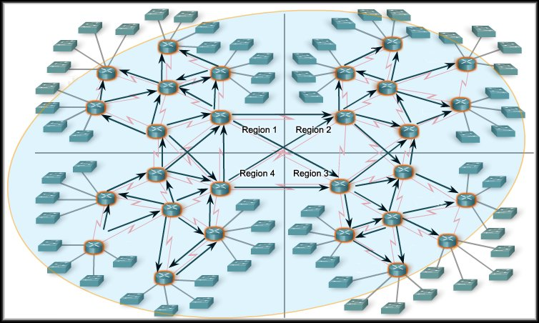
Convergence
The amount of time it takes for a network to converge is directly proportional to the size of that network.
Routing protocols are compared based on how fast they can propagate this information - their speed to convergence.
A network is not completely operable until it has converged.
Network administrators prefer routing protocols with shorter convergence times.

Slide 29
THE END

